Slide 1
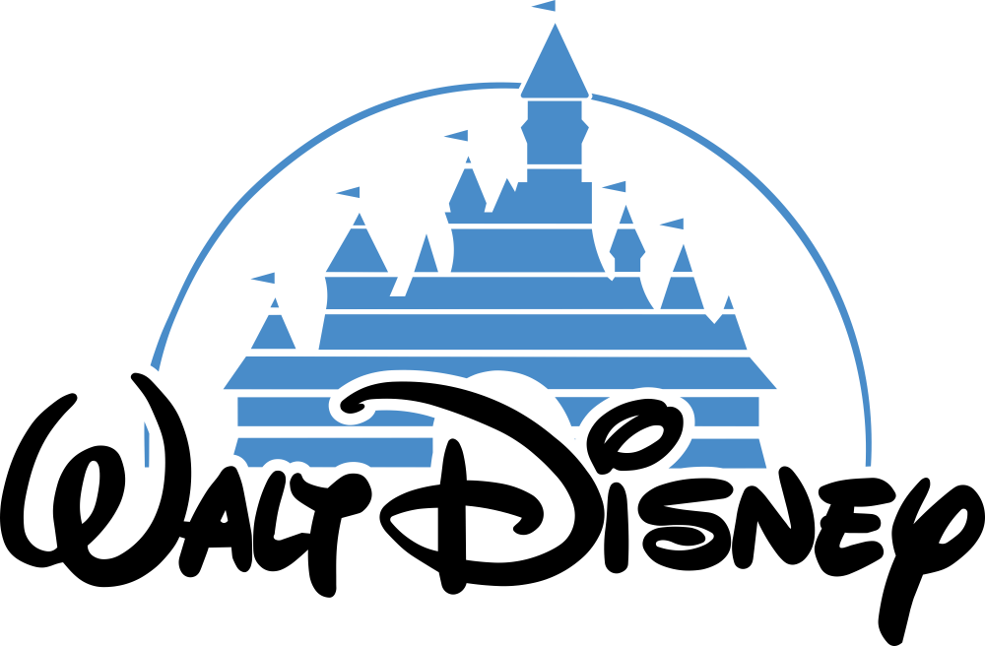
DISNEY COMPANY ANALYSIS
By: Gary Davis & John McGraw

Slide 2
Project Questions to be Answered
Does the current stock price of Disney represent an under-valuation or over-valuation of the company?
What does the valuation of the company look like doing a 5 year discounted cash flow (DCF) model of the company look like considering pessimistic, neutral, and optimistic scenarios?
Does the Monte Carlo simulation of the 5 year outlook for the stock price support the conclusions gained from the DCF model?
Do the financial metrics (PE ratio, price to sales , price to book, net profit margin current ratio, debt to equity, debt to assests, gross profit, and ROE) support the current or projected stock price of Disney?

Slide 3
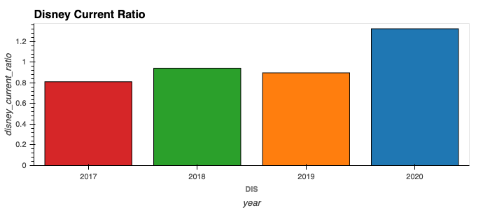
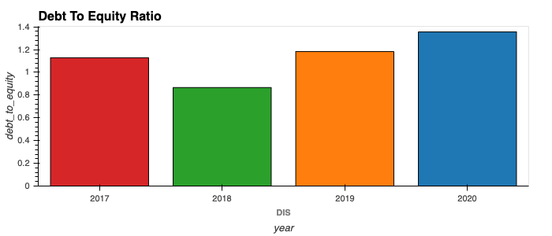
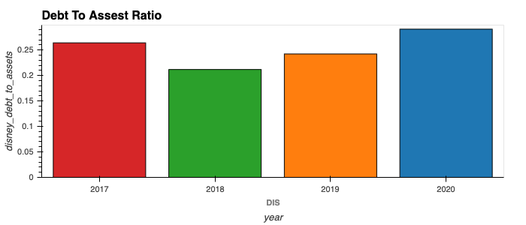
Disney Financial Ratio's

Slide 4
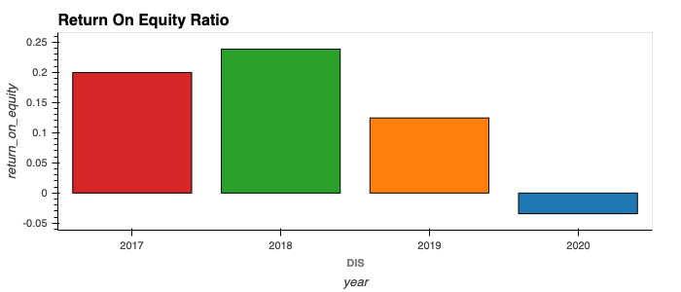
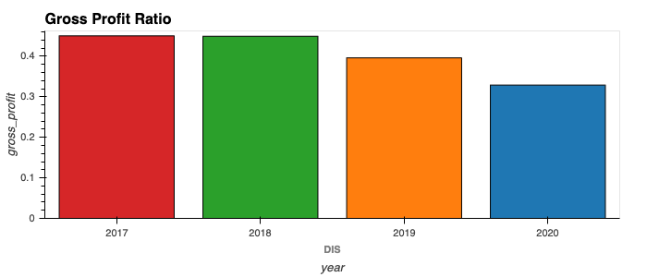
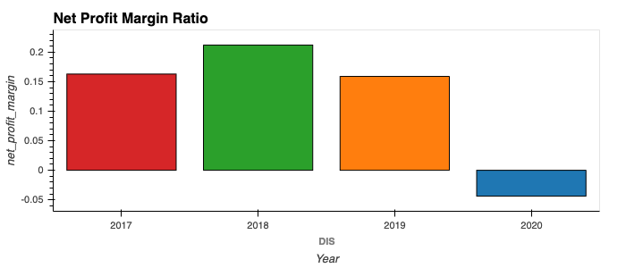
Finanical Ratios Continued

Slide 5
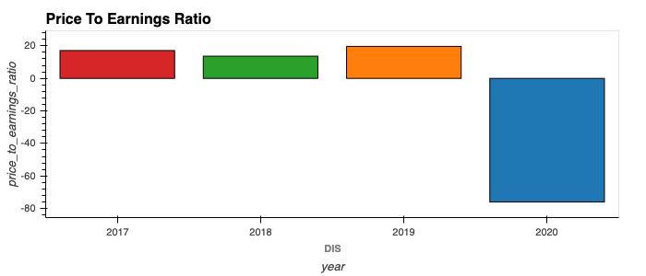
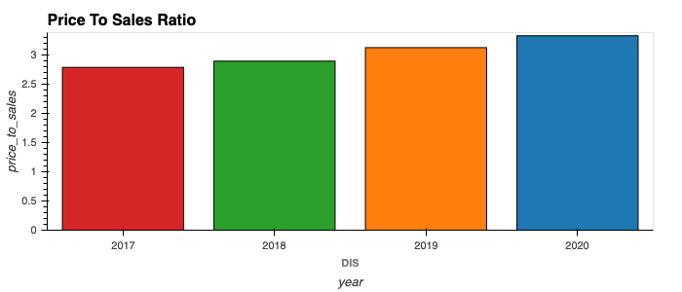
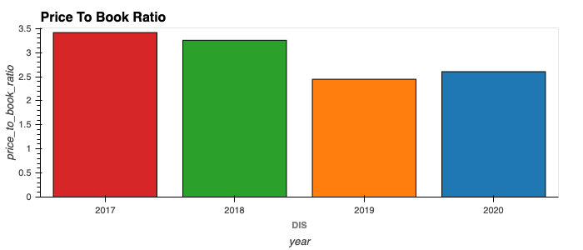
Finanical Ratios Continued

Slide 6
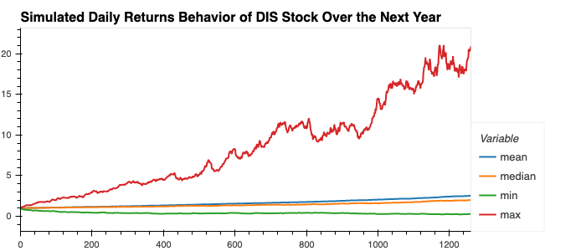
Monte Carlo Simulation

Slide 7
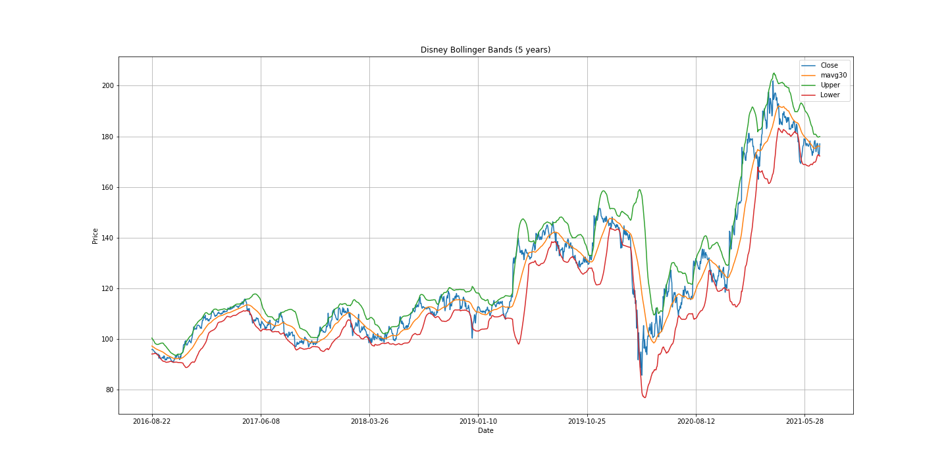
Disney 5-year Bollinger Bands
Bollinger Bands are a type of price envelopes define upper and lower price range levels. Bollinger Bands are envelopes plotted at a standard deviation level above and below a simple moving average of the price. Because the distance of the bands is based on standard deviation, they adjust to volatility swings in the underlying price.

Slide 8
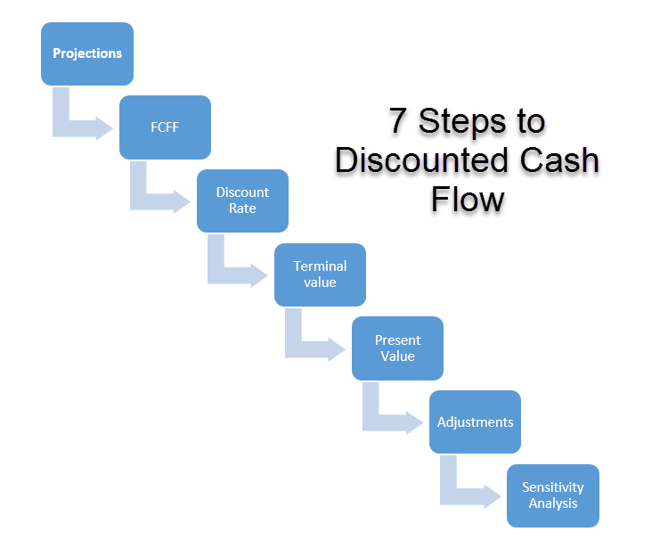
Valuation Methods
Discounted cash flow (DCF) is a valuation method used to estimate the value of an investment based on its expected future cash flows. DCF analysis attempts to figure out the value of an investment today, based on projections of how much money it will generate in the future. Our assumptions –2% growth for pessimistic outlook and 5% growth for optimistic outlook.
EV/EBITDA is a ratio that compares a company’s Enterprise Value (EV) to its Earnings Before Interest, Taxes, Depreciation & Amortization (EBITDA). The EV/EBITDA ratio is commonly used as a valuation metric to compare the relative value of different businesses.
Monte Carlo simulation (presented above).
Five year high/low stock price.

Slide 9
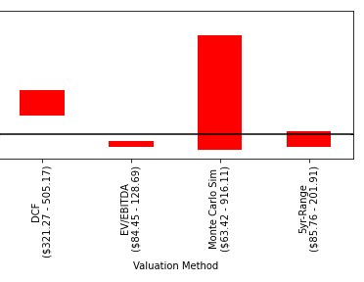
Final Valuation Models

Slide 10
Conclusion
Based on the analysis of the financial ratios and the various valuation methods, we think the current stock price of Disney is neither under- or over-valued. Market and economic conditions will change going forward, but at this time we think it's a sound investment.

